Slide 1





ON DUTY MANAGEMENT SYSTEM
A Web-Based Automation System for Student OD Requests
Technologies Used: React | Spring Boot | MongoDB

Slide 2

ABOUT
ABSTRACT
The On-Duty Application is a digital platform designed to automate and streamline the student/staff on-duty request and approval process.
It replaces manual form-filling with an online system accessible via web and mobile browsers.
Provides real-time status updates for users and reduces administrative workload.
Developed using React for responsive UI, Spring Boot for backend APIs, and MongoDB for data storage.

Slide 3
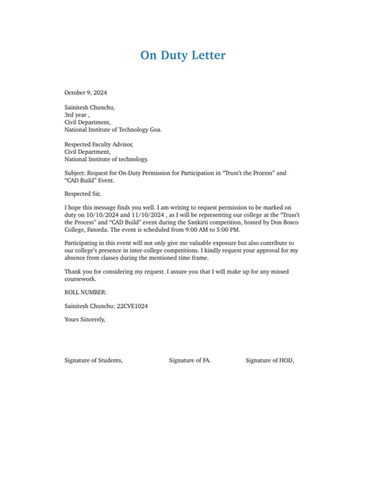
EXISTING SYSTEM
Manual process using paper-based forms or emails.
Delays in approval due to lack of proper tracking.
Difficult to maintain records or generate reports.
No centralized database for requests and approvals.
Communication gaps between student, faculty, and administration.

Slide 4
PROPOSED SYSTEM
A web-based platform where users can apply, track, and manage on-duty requests digitally.
Role-based access: Student, Faculty Advisor, and Admin.
Automated notifications for request approval/rejection.
Centralized database using MongoDB for secure storage.
Backend APIs handled by Spring Boot, ensuring scalability and security.
Responsive frontend built with React for smooth user interaction.

Slide 5


Advantages
Time-saving and efficient process.
Paperless and eco-friendly solution.
Easy tracking of request status.
Secure data storage and quick retrieval.
Reduces administrative workload.
Accessible from anywhere via web browser.

Slide 6


DISADVANTAGES
Requires internet connectivity.
Initial setup and training needed.
Dependent on server uptime.
Possible data privacy concerns if not secured properly.

Slide 7

HARDWARE REQUIREMENTS
Processor: Intel i3 or higher
RAM: Minimum 4 GB
Storage: 100 GB (for server & database)
System Type: 64-bit OS
Network: Internet connection for hosting and usage

Slide 8

SOFTWARE REQUIREMENTS
Frontend: React.js, HTML, CSS, JavaScript
Backend: Spring Boot (Java)
Database: MongoDB
Server: Apache Tomcat or Spring Boot Embedded Server
Development Tools: VS Code, IntelliJ IDEA, MongoDB Compass, Postman
Operating System: Windows / Linux

Slide 9

Modules
Login & Authentication Module
Student Request Module
Faculty Approval Module
Admin Management Module
Notification Module
Report Generation Module

Slide 10
Module Description
Login & Authentication:
Validates users (Student, Faculty, Admin) using credentials and roles.
Student Request:
Allows students to submit on-duty forms with event details and dates.
Faculty Approval:
Faculty can view, approve, or reject requests with comments.
Admin Management:
Manages user accounts, system settings, and generates summary reports.
Notification Module:
Sends status updates to users via email or dashboard alerts.
Report Generation:
Provides monthly/semester-wise OD statistics for analysis.

Slide 11
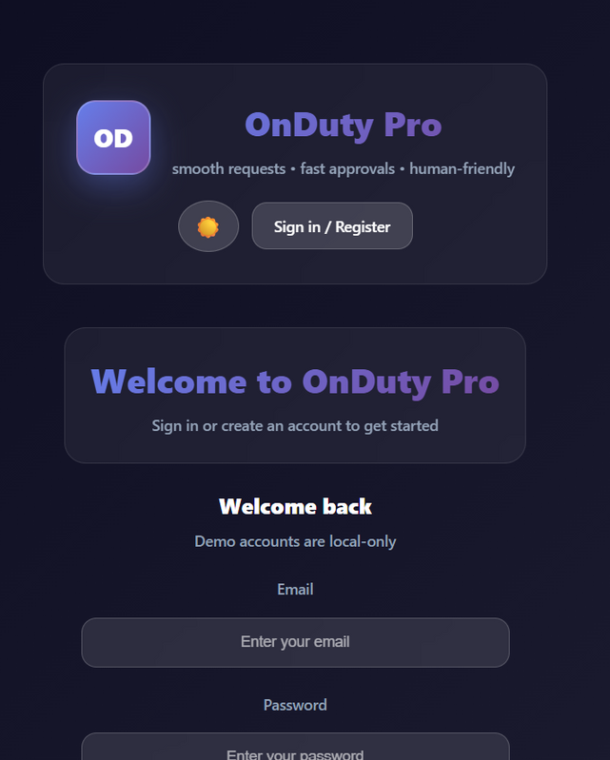
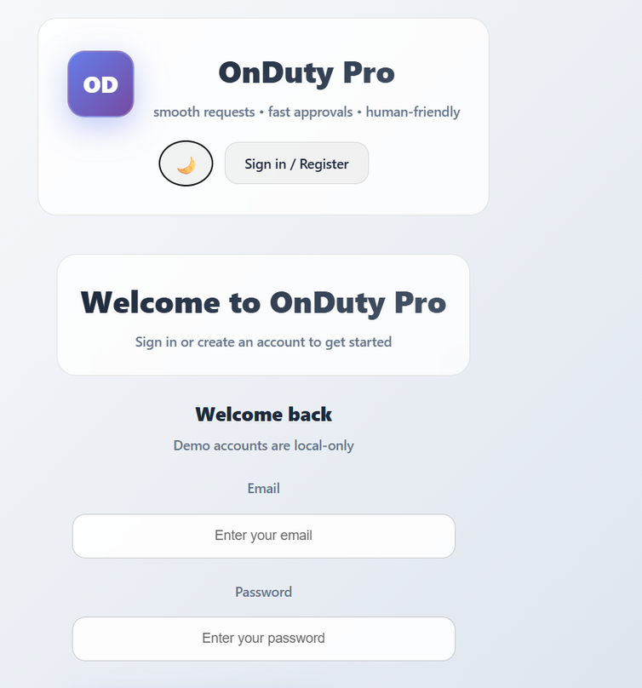
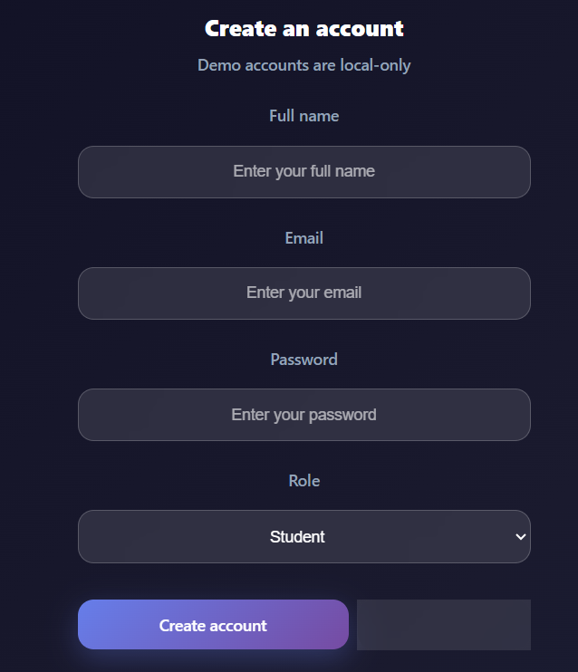
SAMPLE OUTPUT

Slide 12
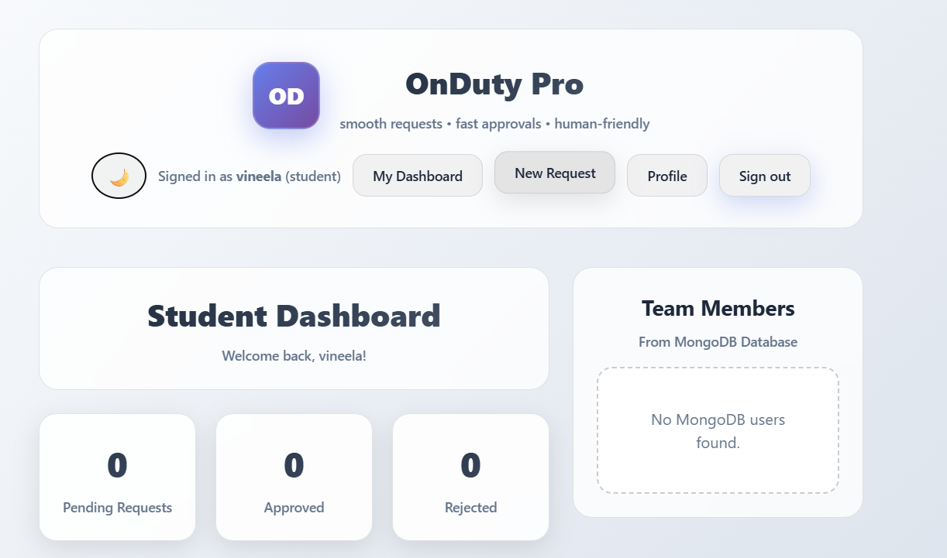
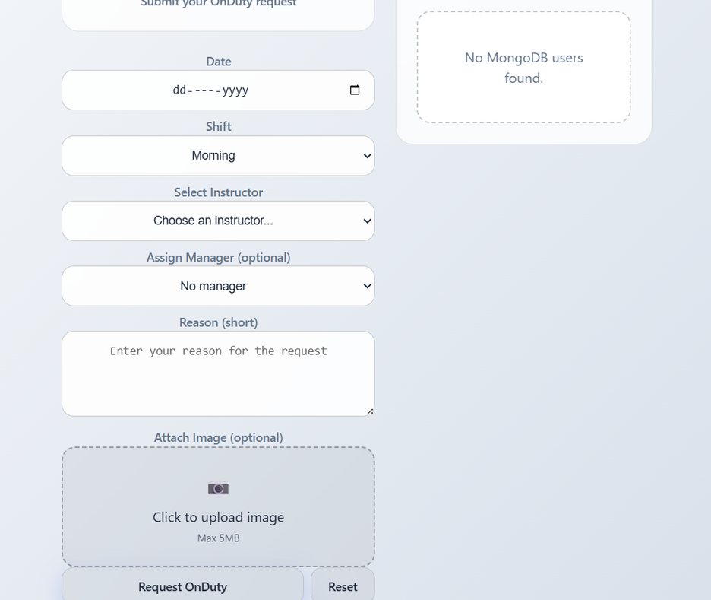
SAMPLE OUTPUT

Slide 13
THANK YOU

